Slide 1
SUPERVISED ML CLASSFICATION Capstone Project
PREDICTING SENTIMENT OF COVID-19 TWEETS By- Sneha Raikar

Slide 2

Contents
Problem Statement
Data Inspection
Data Analysis
Removing Punctuations
Removing Stopwords
Removing Hashtags
Count Vectorizer
Implementing Algorithms
Conclusion

Slide 3
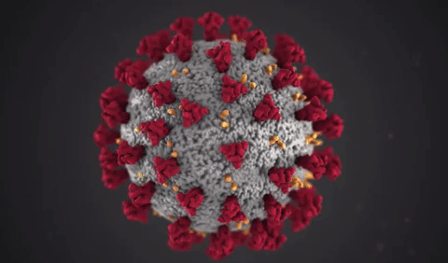
Introduction:
Among the most common viral infections that affect humans are the respiratory infections, which are caused by Human Respiratory Viruses (RVs) .The best-known type of respiratory viral infection is the influenza or "flu", and every year causes between 250,000 and 500,000 deaths worldwide, being the H1N1 virus the most well-known variant .One of the family of viruses that causes respiratory diseases is the corona virus, which in humans infects the epithelial cells of the respiratory tract, being sometimes unnoticeable, but in some cases deadly, and can even affect other mammals and birds. There are several types of corona viruses, the best-known are The Middle East Respiratory Syndrome (MERS), the Severe Acute Respiratory Syndrome (SARS) and nowadays the Corona virus Disease (COVID-19).
.

Slide 4

Problem Statement:
The diseases that currently affect the world, especially which are classified as pandemic, cause serious problems to the population at all levels: economic, emotional, status, planning, politics, etc., in addition to the complexity of traditions, ethics, individual psychology and social behavior of people. Therefore, it is required and necessary a people's attitudes analysis when adverse situations arise. Identifying people's reaction to this threat can provide important information on how society behaves and reacts to unwanted and unexpected situations, which can be positive or negative, currently the Internet and social networks have become powerful tools to access people’s opinions and comments on various topics .The main objective is to make a predictive model, which could help in predicting the Sentiment of tweets.

Slide 5
Data Analysis Steps:
Imported Libraries
In this part, we imported the required libraries NumPy, Pandas, matplotlib, and seaborn, to perform Exploratory Data Analysis and for prediction, we imported the Scikit learn library.
Descriptive Statistics
In this part, we start by looking at descriptive statistic parameters for the dataset. We will use describe() this told mean, median, standard deviation
Missing Value Imputation
We will now check for missing values in our dataset. after checking not existed any missing values, In case there are any missing entries, we will impute them with appropriate values.
Graphical Representation
We will start with Univariate Analysis, bivariate Analysis and conclude with various prediction models helps us predict the Risk.

Slide 6
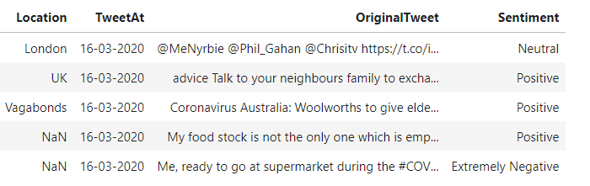
Attribute Information
Location - location of country
Tweet At – timestamp of tweets
Original Tweet – textual content of tweets
Label – Sentiment of the tweets

Slide 7
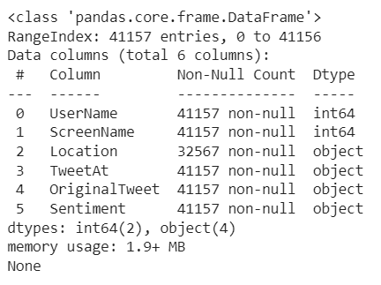
Data Inspection:
This Dataset has contains 41,157 rows and 6 columns.
Location - location of country
Tweet At – timestamp of tweets
Original Tweet – textual content of tweets
Label – Sentiment of the tweets

Slide 8
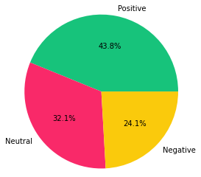
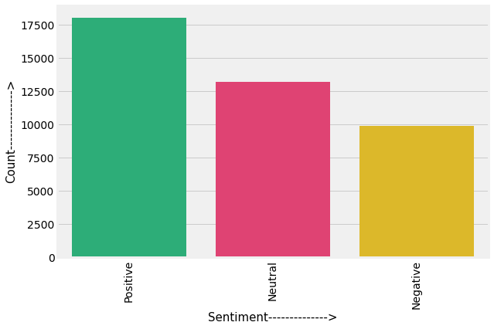
Sentiment Analysis
Sentiment analysis (or opinion mining) is a natural language processing (NLP) technique used to determine whether data is positive, negative or neutral. Sentiment analysis is often performed on textual data to help businesses monitor brand and product sentiment in customer feedback, and understand customer needs.

Slide 9
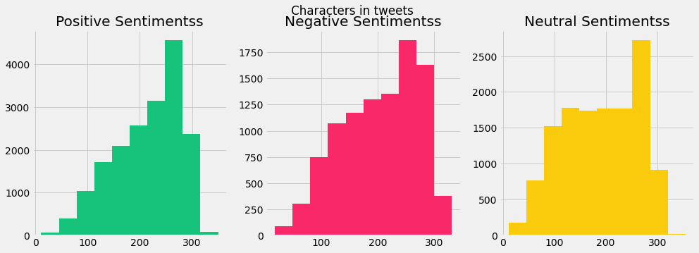
Number of characters in a Tweet
As we can see the number of character used in positive sentiments is between 400-4000.On the other hand for negative sentiments its between 250-1750 and for neutral sentiments its between 200-2500.

Slide 10
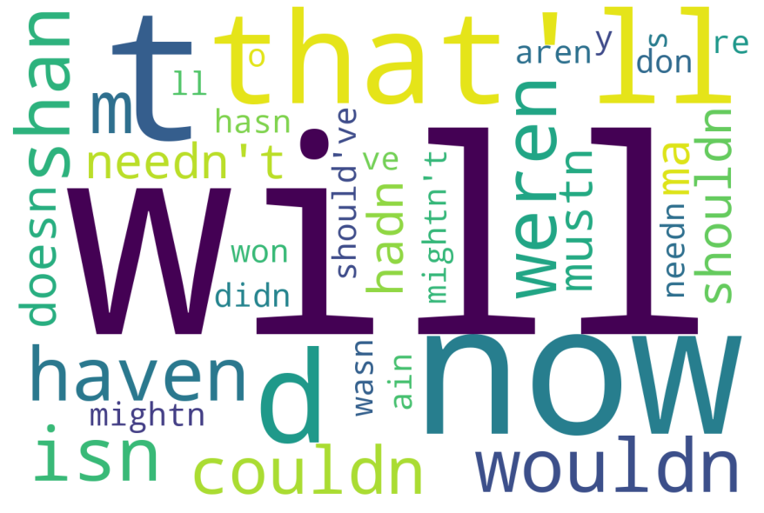
Common Stopwords in the tweets
Here we plot word cloud that shows the common stop words that a person used in a tweet whether its positive, negative or neutral sentiments.

Slide 11
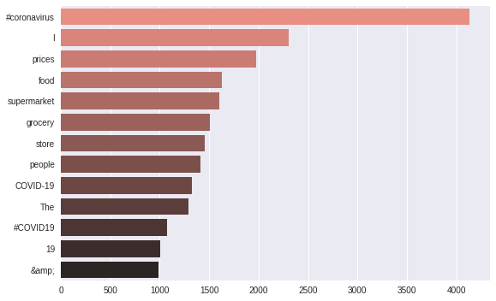
Common Stopwords in the tweets
Here we use bar plot that shows the common words that a person used in a tweet whether its positive, negative or neutral sentiments.

Slide 12
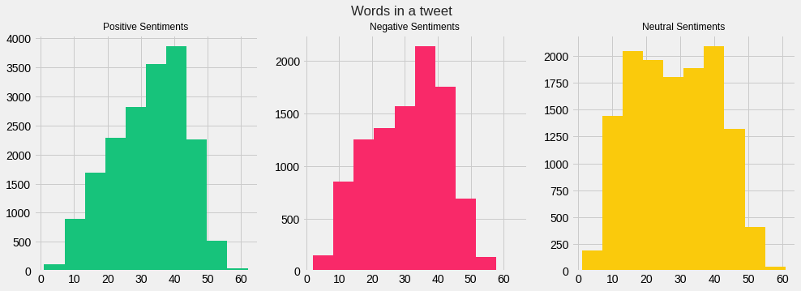
Number of words in a Tweet
As we can see the number of words used in positive sentiments is between 100-3800.on the other hand for negative sentiments its between 100-2100 and for neutral sentiments its between 200-2000.

Slide 13
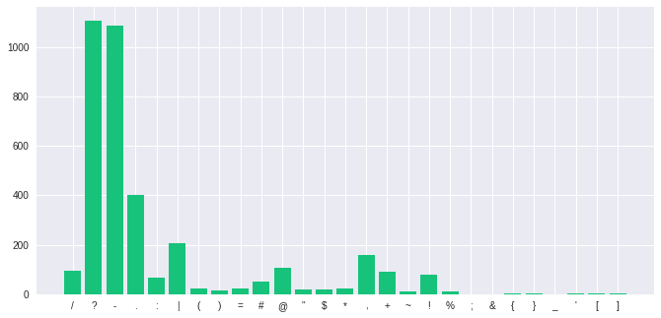
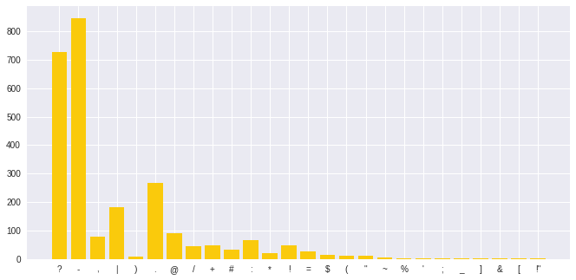
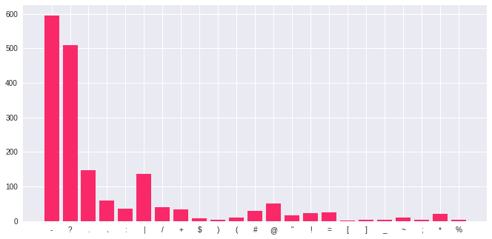
Number of Punctuations
Punctuations used by a person in a tweet.
Green colour histogram represent positive sentiments punctuations.
Pink colour histogram represent Negative sentiments punctuations.
Yellow colour histogram represent Neutral sentiments punctuations.

Slide 14
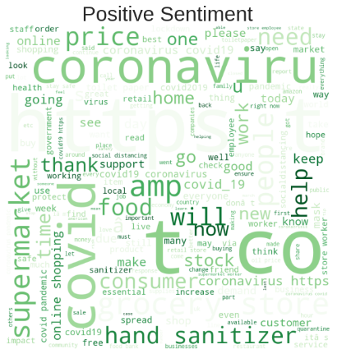
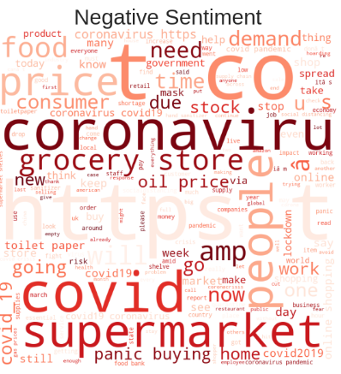
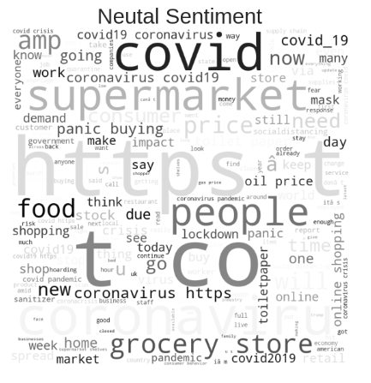
Mentions used in a Tweet

Slide 15
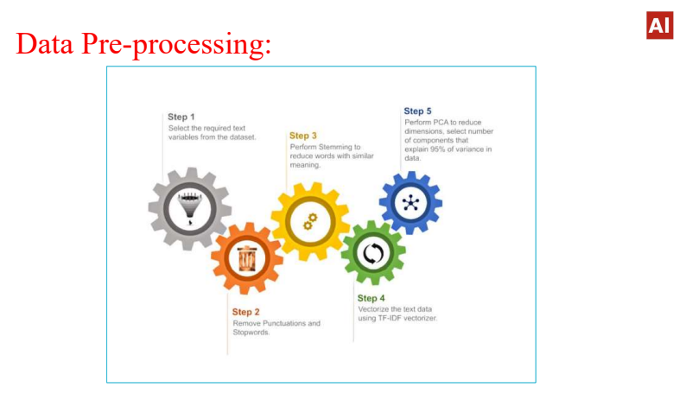

Slide 16
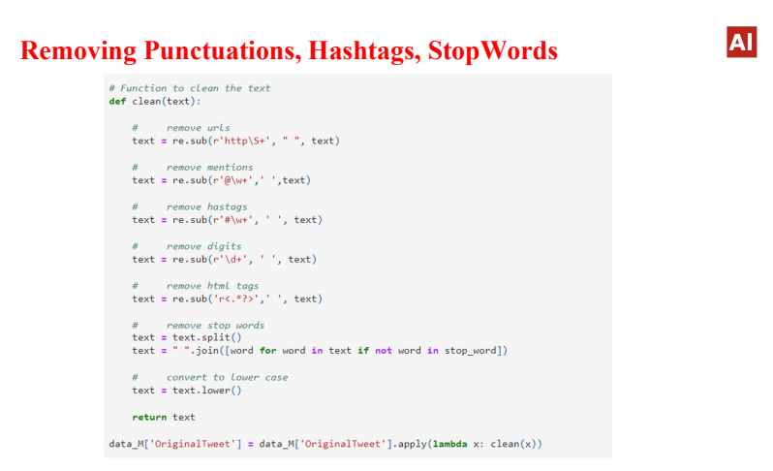

Slide 17
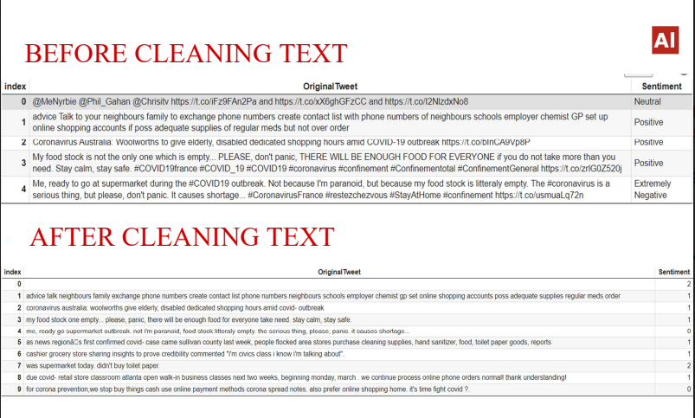

Slide 18
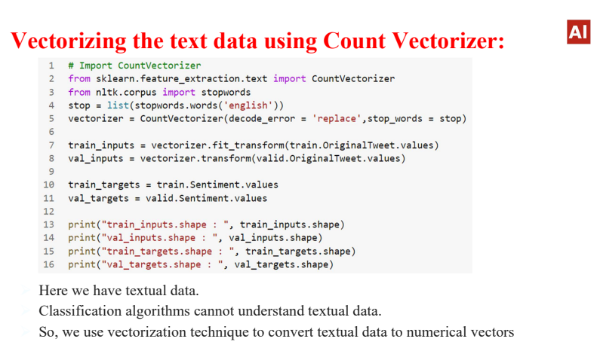

Slide 19
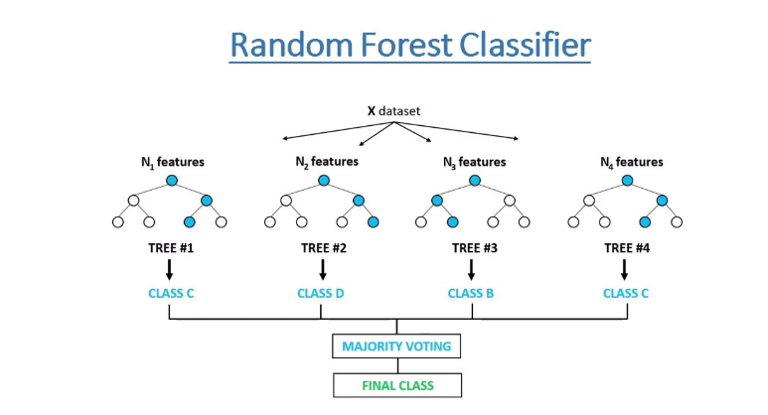
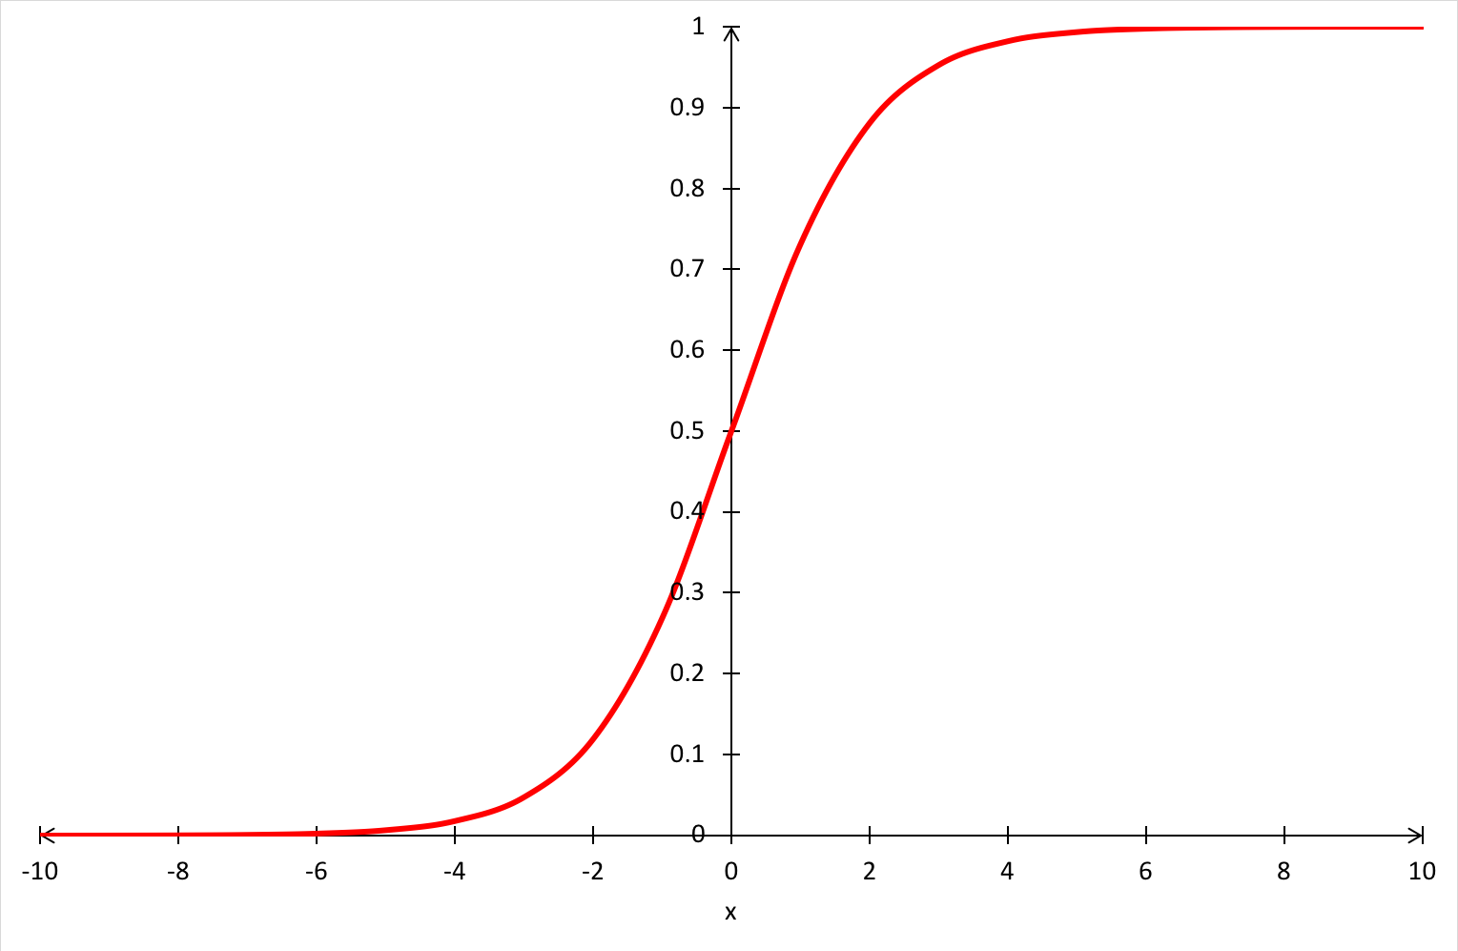
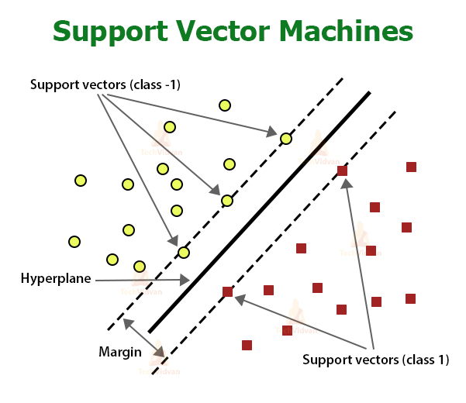
Model Building:
Logistic Regression

Slide 20
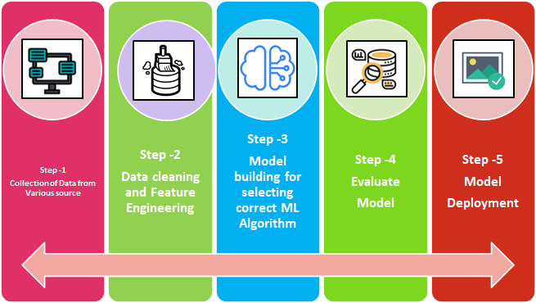
Machine Learning Process Flow:

Slide 21
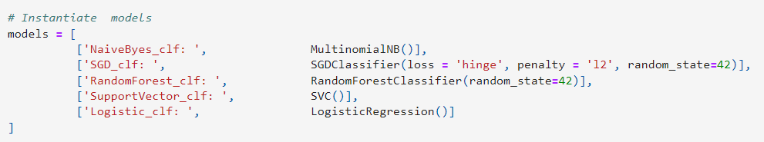
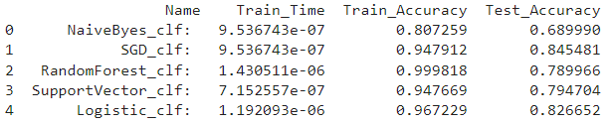
Comparing different Models for Multiclass Classification
In the above Models Evaluation Table(Testing set) our accuracy score is less than 0.80 except Logistic Classifier and Stochastic gradient descent classifier.So we can say that our model predicted the classes in a good manner.
SGD Classifier is performing well which has best Recall,Precision,F1-Score and Accuracy Score.

Slide 22
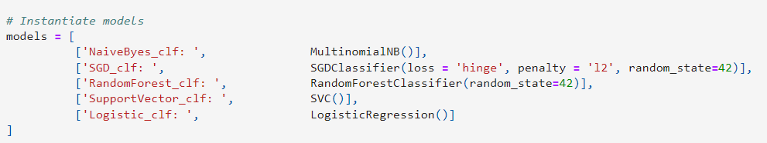
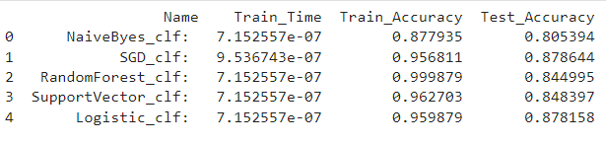
Comparing different Models for Binary Classification
In the above Models Evaluation Table(Testing set) our accuracy score is more than 0.80 except Logistic Classifier and Stochastic gradient descent classifier.So we can say that our model predicted the classes in a good manner.
Logistic Regression Classifier is performing well which has best Recall,Precision,F1-Score and Accuracy Score.

Slide 23
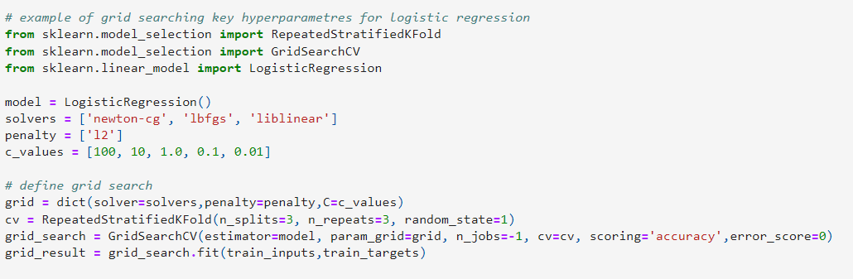
Hyperparameter tuning for logistic regression classifier
In the above hyperparameter tunning we used grid search cv to find the best parameters to train our logistic regression classifier

Slide 24
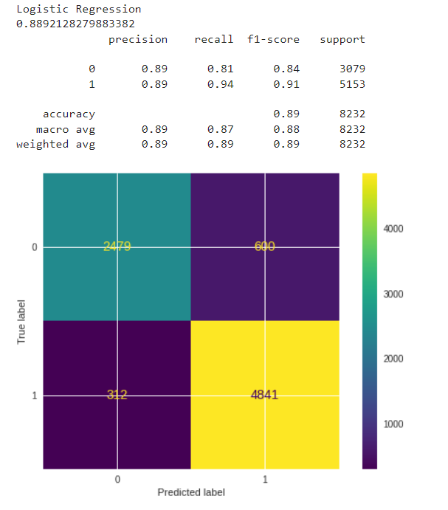
Performance metrics for Logistic classifier
Here 0 represent Negative Sentiments whereases 1 represent Positive Sentiments and Neutral Sentiments.
Model Accuracy score is 89%

Slide 25
Conclusion
Taking into account that the COVID-19 disease is global health problem and has affected most countries and their economies, this model focuses on analyzing people’s reaction to the pandemic. The main goal of the model is to deduce whether the sentiment of the public opinion is positive or negative by applying machine learning algorithms and NLP techniques. Despite the fact that the analysis found variation of opinions, it seems that people mostly remain positive about the pandemic, January is the only month in which negative thoughts predominated, March is the month when the COVID-19disease was declared as a pandemic and many countries started to apply care measures and safety protocols, which coincides with the rise of positive thoughts.
To summarize, 62% of the users showed positive feelings and 38% of the
users showed negative feelings.

Slide 26
THANK YOU

